Slide 1





GDG MIT
Search
INTRODUCTION TO
GITHUB & OPEN SOURCE
git init
https://linktr.ee/gdg.mit

Slide 2


GDG MIT
Search
GIT
GITHUB
Git is a open-source version control system for tracking changes in files locally, enabling branching, merging, committing.
GitHub is a proprietary cloud-based platform that hosts Git repositories, enabling collaboration, remote access, and additional project management tools.

Slide 3
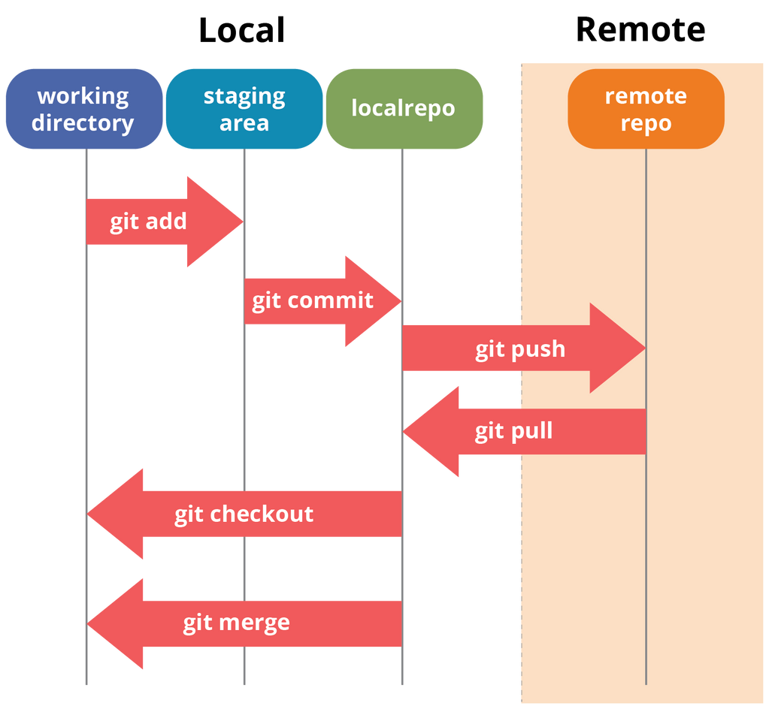
GDG MIT
GIT WORKING
Search

Slide 4
GDG MIT
Search
Repository
Issues & Pull Requests (PRs)
A project folder where all your files, including code, documentation, and assets, are stored.
Issues are for tracking bugs, tasks, or features and PRs are for Proposed changes to be merged into main code.
Commit
Branch
A snapshot of your changes. Think of them as a way to record the evolution of your project.
Separate copies workspaces for development. Main branch (usually main or master) is the stable version, while other branches are for new features or fixes.
KEY CONCEPTS
OF GITHUB

Slide 5

GDG MIT
GITHUB COPILOT
Search

Slide 6

GDG MIT
GITHUB COPILOT
Search
https://github.com/education/students

Slide 7



GDG MIT
Search
OPEN
SOURCE
Software that is made freely available for anyone to use, modify, and distribute.

Slide 8
GDG MIT
Search
OPEN SOURCE
CONTRIBUTIONS
Open source contributions involve participating in publicly accessible projects whose source code is open for anyone to view, use, modify, and distribute. Contributions can range from writing code to documentation, testing, design, and more, benefiting the broader community by improving software and fostering collaboration.

Slide 9

WHY CONTRIBUTE TO OPEN SOURCE ?
GDG MIT
Search
Learn new technologies, frameworks, and best coding practices.
Gain experience working in real-world software development environments.
Build an impressive portfolio showcasing your contributions.
Many companies value open-source experience in hiring.
Connect with like-minded developers and influential contributors in the tech industry.
Contribute to the tech community by improving tools you or others use.
Experience workflows like code reviews, version control, and team discussions.

Slide 10

GDG MIT
MARKET
Search
OPPORTUNITY
1) Hacktoberfest - An annual event that encourages contributions to open-source repositories in October.
2) Google Summer of Code (GSoC) - A program for students to work on open-source projects under mentorship of top companies.
3) GirlScript Summer of Code (GSSoC) - A beginner friendly open-source program that aims to introduce students to the open-source world.
4) Season of Docs - Focused on improving documentation for open-source projects.

Slide 11
ESSENTIAL GIT COMMANDS
Search
git init
git fork [repository URL]
Initialize a new Git repository in the current directory.
Fork a repository directly from GitHub to create a personal copy and to make changes without affecting the original project.
git clone [repository URL]
git remote -v
Clone an existing repository from GitHub to your local machine.
Show the list of remote repositories connected to your local repository.

Slide 12
ESSENTIAL GIT COMMANDS
Search
git remote add [name] [url]
git pull [remote] [branch]
Add a new remote repository (for example, when you want to add a remote to your fork).
Fetch the latest changes from a remote and merge them into your current branch.
git branch [branch-name]
git checkout [branch-name]
Create a new branch locally.
Switch to a different branch.

Slide 13
ESSENTIAL GIT COMMANDS
Search
git checkout -b [branch-name]
git merge [branch-name]
Create a new branch and switch to it in one command.
Merge a specific branch into your current branch.
git remote add upstream [repo URL]
git fetch upstream
Add the original repository (upstream) as a remote to keep your fork updated with changes from the main project.
Fetch the changes from the upstream repository.

Slide 14
ESSENTIAL GIT COMMANDS
Search
git push origin [branch-name]
git push --set-upstream origin [branch]
Push your changes to your remote repository.
Push a new branch to the remote and set it to track the remote branch.
git rebase [branch-name]
git status
Rebase your current branch on top of the specified branch in a cleaner, linear commit history.
Check the status of the repository to see which files are created / updated / deleted.

Slide 15
ESSENTIAL GIT COMMANDS
Search
git commit
git reset [commit]
Commit the merged changes.
Reset your current branch to the specified commit. This command modifies history, so be careful when using it.
git diff
git log
Show the changes between your working directory and the last commit.
View the commit history for your repository.

Slide 16
GDG MIT
Search
GITHUB PROFILE
README.MD
It’s the first thing people see when they visit your profile, so it can make your profile stand out.
Share who you are, what you do, and what you’re passionate about.
Acts as a professional journey guide for your profile visitors / recruiters.
Helps to collaborate with like-minded people.

Slide 17
GDG MIT
Search
HANDS ON
💡 Code is more than just lines of text—it's a way to connect, collaborate, and create impact. With every open-source contribution, you leave a mark on the world of innovation 🚀
git status
https://linktr.ee/gdg.mit

